Slide 1

Homework assignment

Slide 2


Slide 3
Lesson agenda
CSS
Selectors
Specificity
Quick intro to JS (static vs dynamic web page)

Slide 4
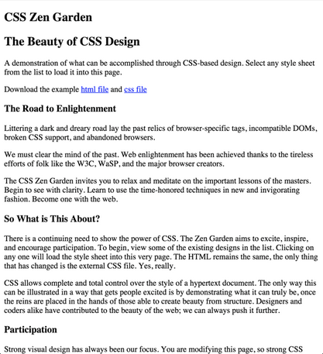
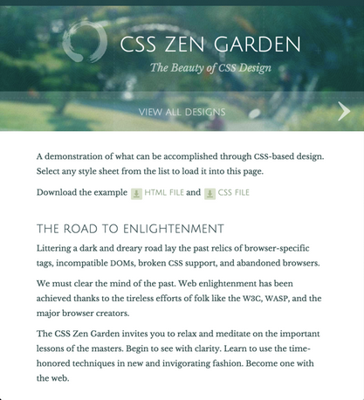
Example
Plain HTML vs HTML with CSS:

Slide 5
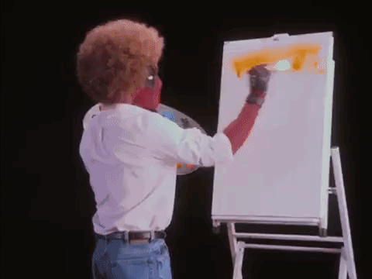
Notes:
https://en.wikipedia.org/wiki/Bob_Ross
https://www.youtube.com/channel/UCxcnsr1R5Ge_fbTu5ajt8DQ

Slide 6
What is CSS?
Cascading Style Sheets (CSS)
describes the presentation of a document written in HTML or XML
not really a programming language, not a markup language either — it is a style sheet language

Slide 7
How does it work?
Select HTML element
Choose style property
Choose value for that property

Slide 8

CSS semantics

Slide 9
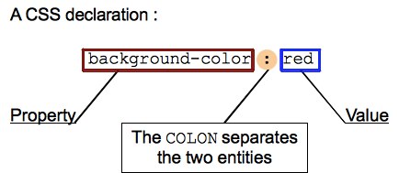
CSS declaration

Slide 10
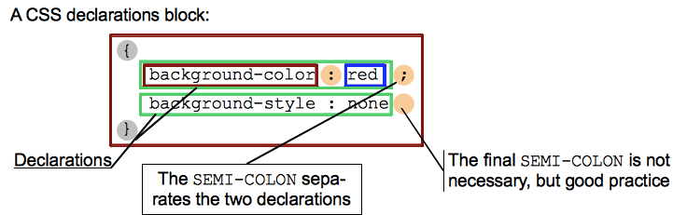
CSS declaration block

Slide 11
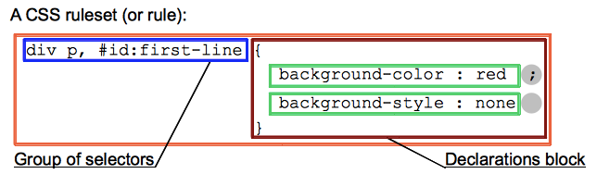
CSS ruleset

Slide 12
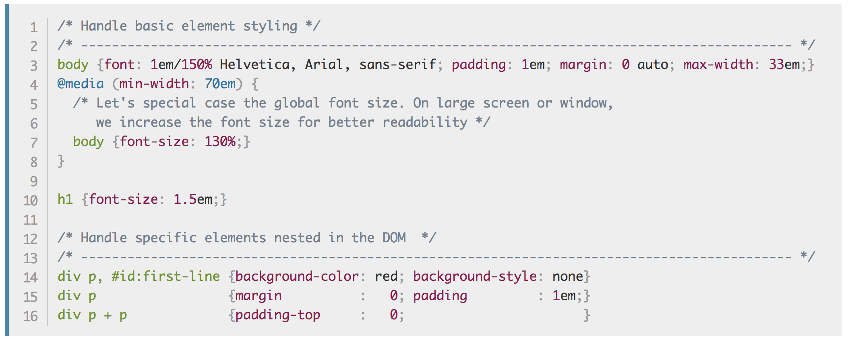
CSS comments

Slide 13
Selector by name

Slide 14
Selector by .class

Slide 15
Selector by #id

Slide 16
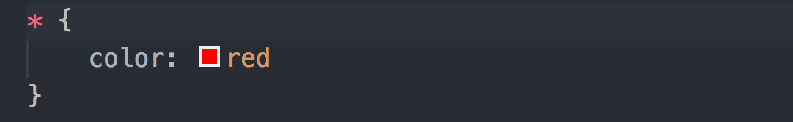
Universal selector

Slide 17
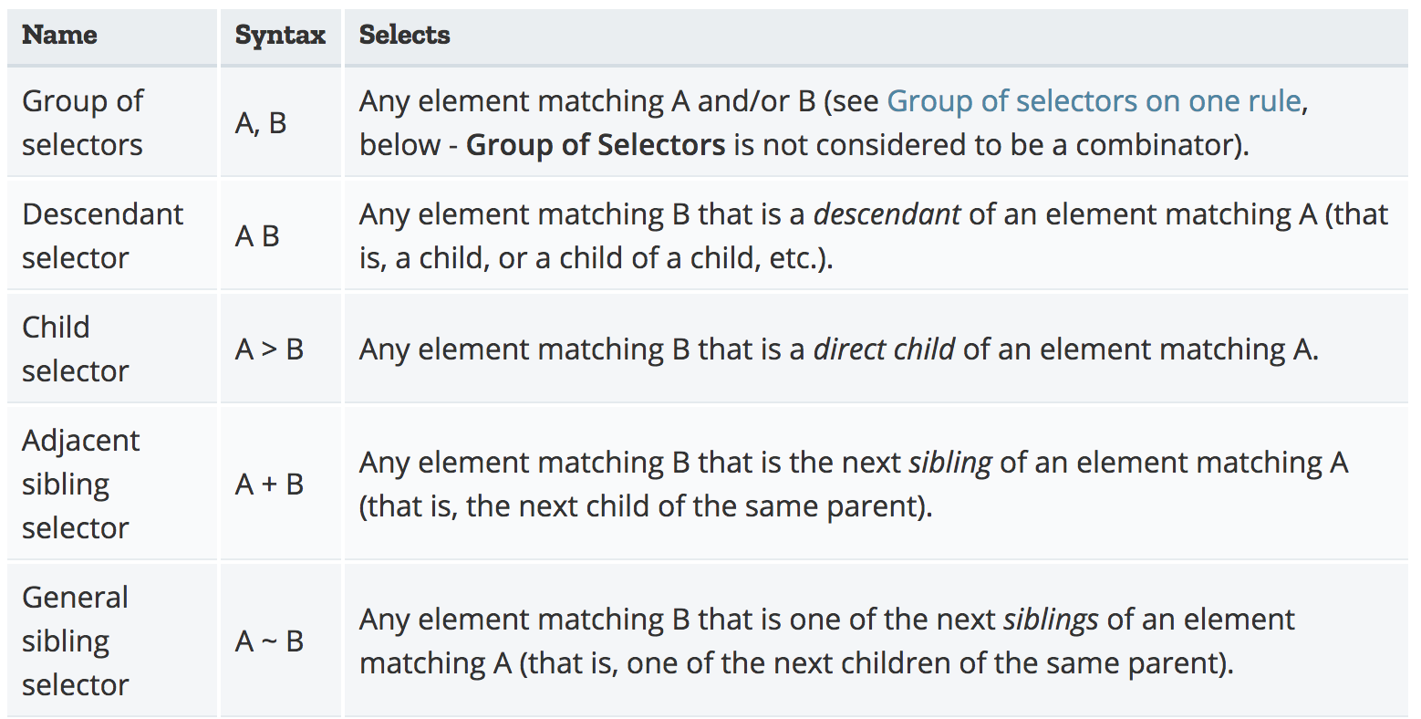
Combinators

Slide 18
Properties
background-color
background-image
border
font-family
font-size
font-weight
color
width
height
https://developer.mozilla.org/en-US/docs/Web/CSS/Reference

Slide 19
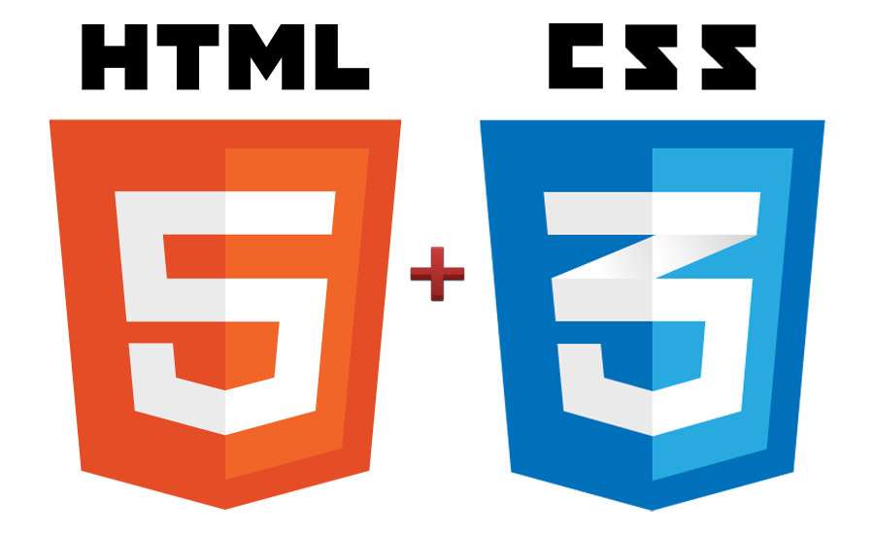
How to add style to your HTML?
There are three ways to do it:
Inline
Adding it in <head> section
Linking css document

Slide 20
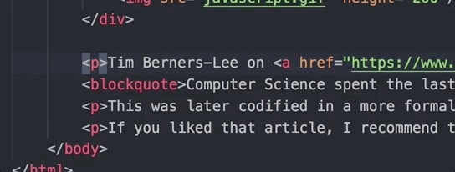
Inline style

Slide 21
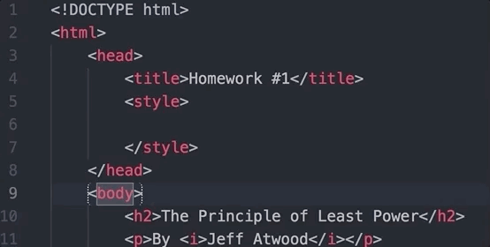
<style>

Slide 22
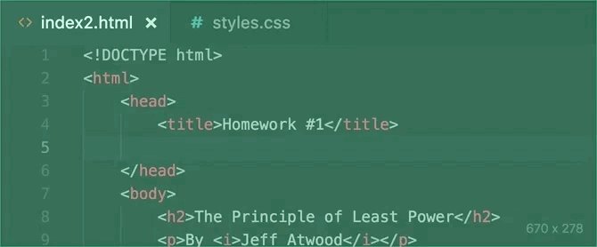
Linking css file

Slide 23
Exercise 1
Add styles in three different ways:
Inline
In Head element
In a separate css file
Add styles using different selectors:
Element
Class
ID
Try these properties:
background-color
border
font-family
font-size
font-weight
height

Slide 24
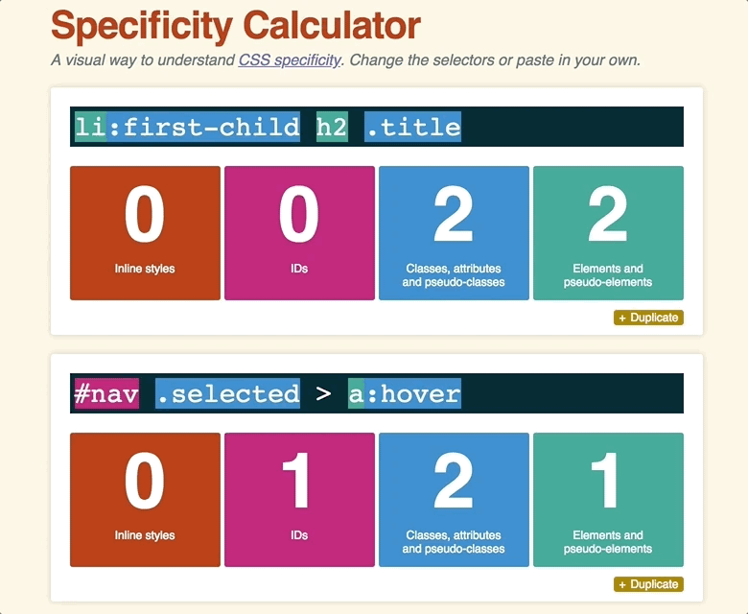
CSS specificity calculator
https://specificity.keegan.st/

Slide 25


Slide 26
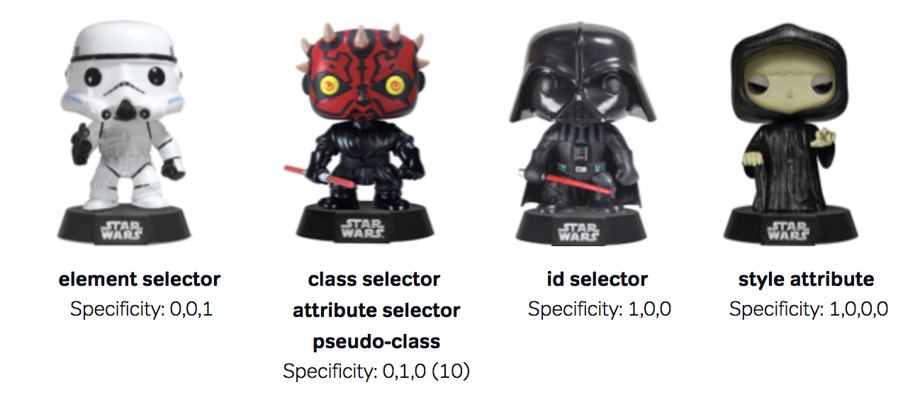
W3C really is in a galaxy far, far away!
Notes:
https://stuffandnonsense.co.uk/archives/css_specificity_wars.html
Each character (selector) is given its own Sith power (specificity value) depending on how powerful they are in the ways of the Dark Side:
A storm trooper (element selector) is less powerful than Darth Maul (class selector*)
Darth Maul is less powerful than Darth Vader (ID selector)
Darth Vader is less powerful than the than the Emperor (style attribute)
The Death Star blows up everything

Slide 27
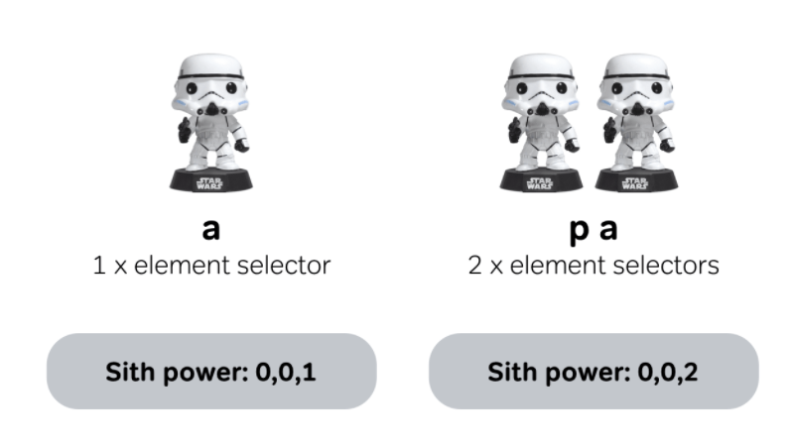

Slide 28
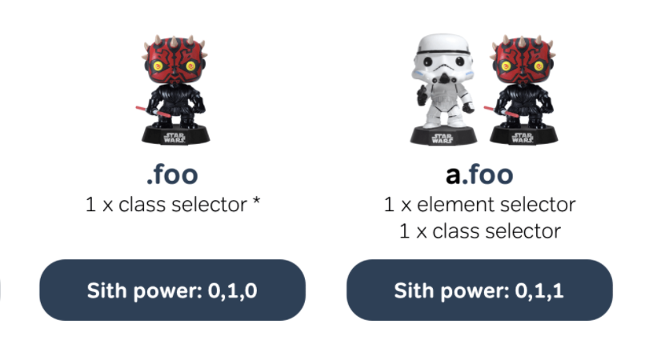

Slide 29
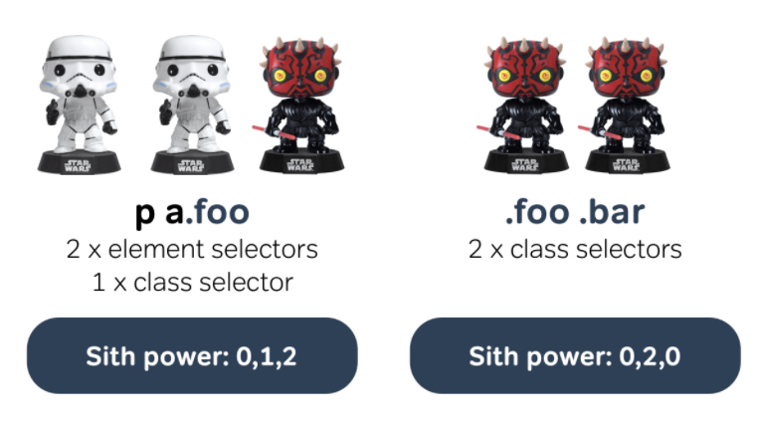

Slide 30
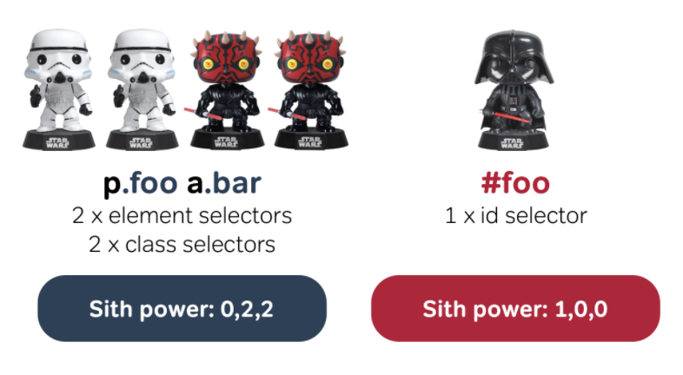

Slide 31
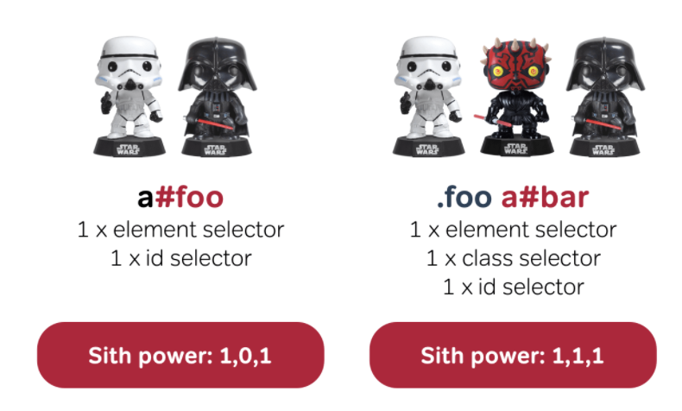

Slide 32
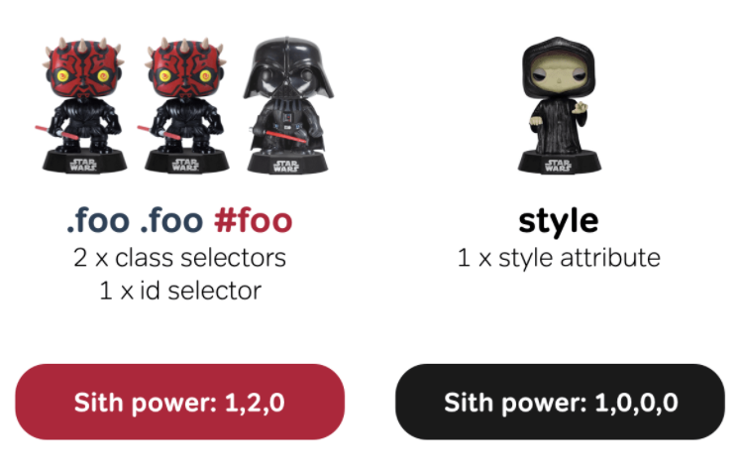

Slide 33
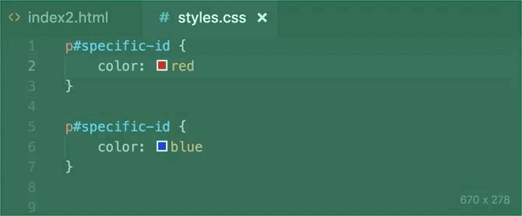
!important

Slide 34
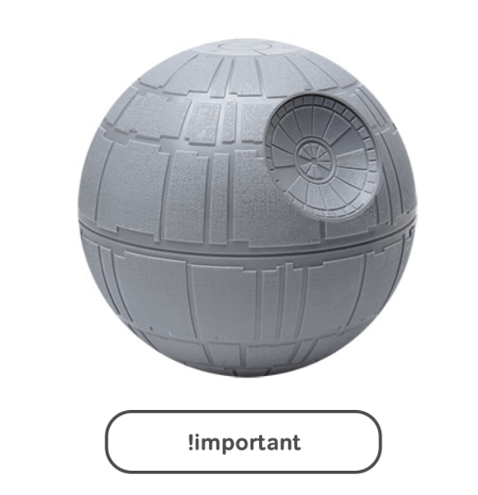

Slide 35
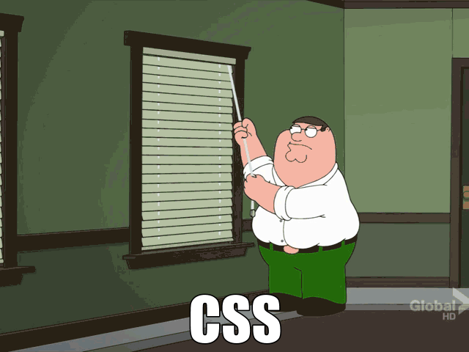
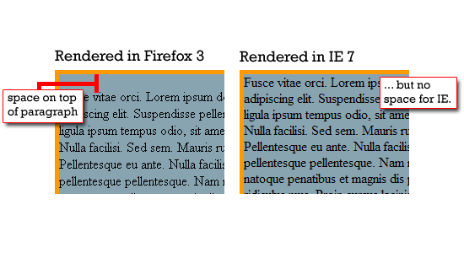
CSS reset
Notes:
Kiekviena naršyklė turi savo numatytą (default) html elementų atvaizdavimą. Kitaip sakant default css reikšmes.
Jos skiriasi tarp skirtingų naršyklių.
Kad suvienodinti puslapio išvaizdą skirtingose naršyklėse, yra sukurti specialūs css failai, kurie nustato vienodas reikšmes visoms naršyklėms.
http://cssreset.com/scripts/eric-meyer-reset-css/
http://html5doctor.com/html-5-reset-stylesheet/
https://necolas.github.io/normalize.css/
Du tipai:
Reset - panaikina dauguma taisyklių, kurias naršyklės tau pridėjo.
Normalize - suvienodina išvaizdą, nepanaikina naudingų taisyklių.
Jei naudojamės CSS frameworku, tai nereikia šito daryti.
https://en.wikipedia.org/wiki/CSS_frameworks

Slide 36


Slide 37
JavaScript
JavaScript (JS) is
Lightweight interpreted or JIT-compiled programming language with first-class functions.
Prototype-based, multi-paradigm, dynamic language, supporting object-oriented, imperative, and declarative (e.g. functional programming) styles
Used not only for web pages https://en.wikipedia.org/wiki/JavaScript#Uses_outside_Web_pages

Slide 38
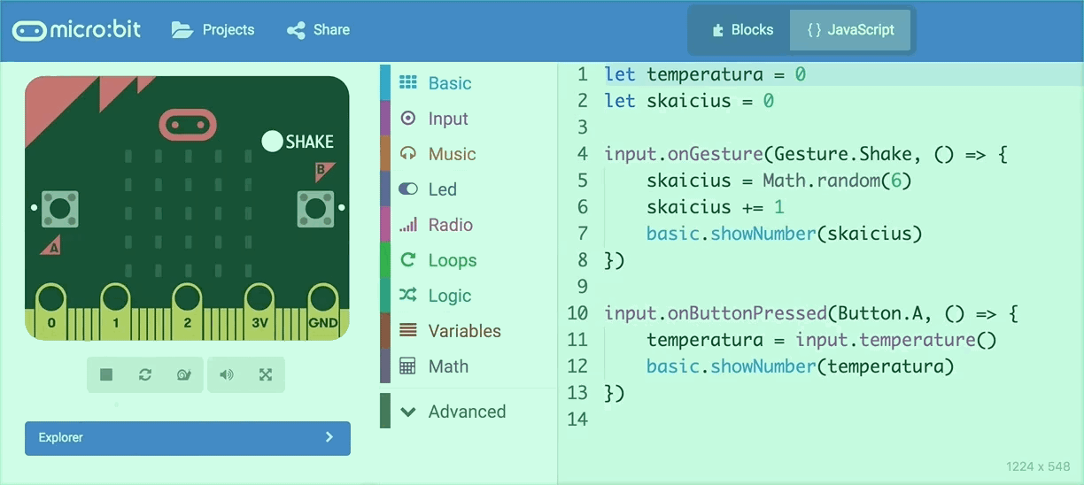
Not just scripting language for web
https://makecode.microbit.org/

Slide 39
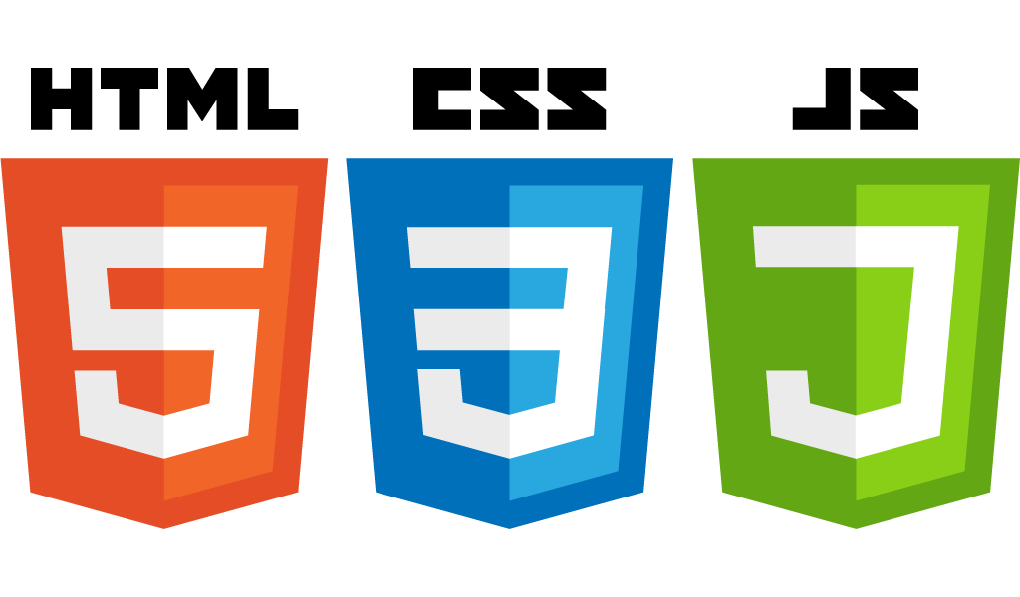
How to add JavaScript to your HTML?
There are three ways to do it:
In <head> using <script>
In <body> using <script>
Linking external JS

Slide 40
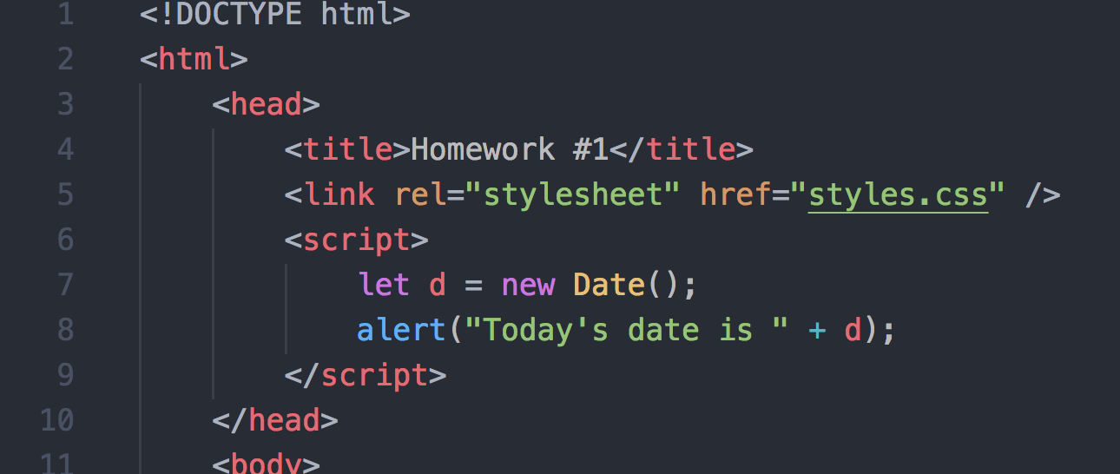
In <head> or <body> using <script> tag

Slide 41
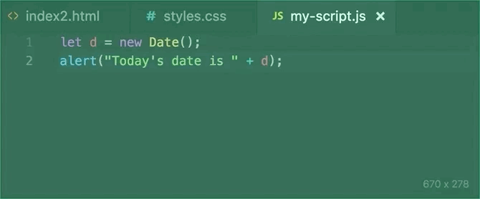
External JavaScript

Slide 42
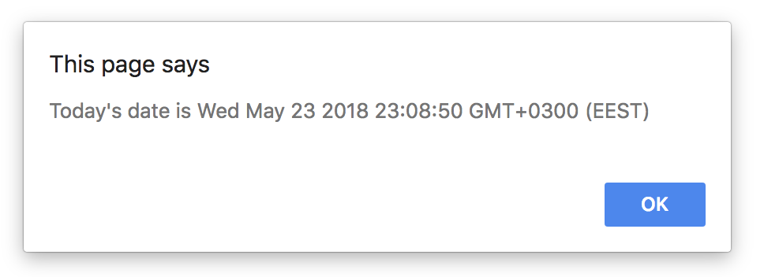
alert

Slide 43
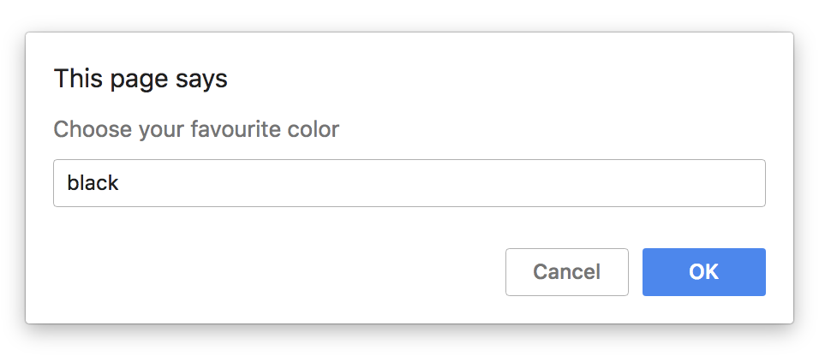
prompt

Slide 44
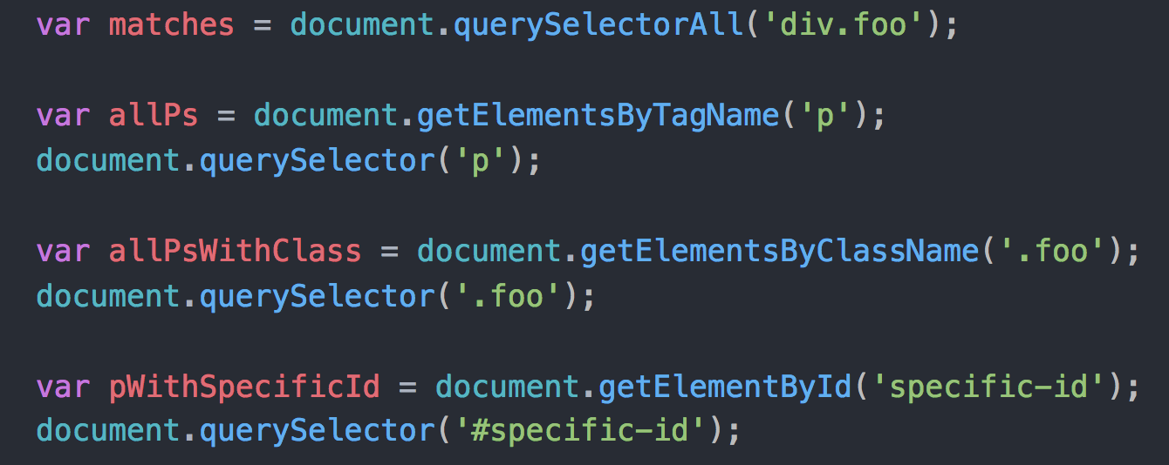
Selecting DOM elements
https://blog.garstasio.com/you-dont-need-jquery/selectors
https://www.w3schools.com/js/js_htmldom_html.asp

Slide 45
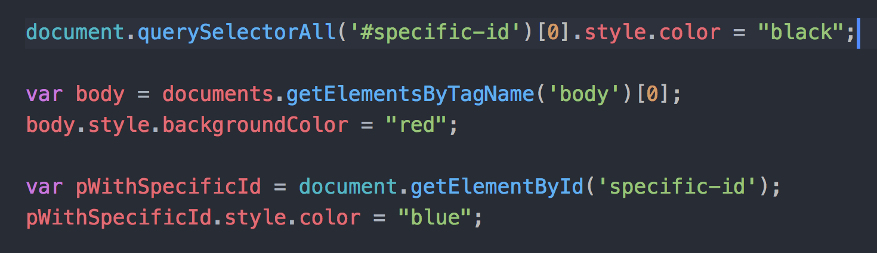
Changing CSS
https://www.w3schools.com/js/js_htmldom_css.asp

Slide 46
Exercise
Add JavaScript file to your project
Link it to your index.html
Show greeting message with alert
Prompt background color
Change one of the paragraphs background color with the given color

Slide 47
